Slide 1
Asymptotic Notations
Md. Muktar Hossain
Lecturer
Dept. of CSE
Varendra university

Slide 2
Introduction
Asymptotic Notations are mathematical tools used to analyze the performance of algorithms by understanding how their efficiency changes as the input size grows.
There are mainly three asymptotic notations:
Big-O Notation (O-notation) ---- Worst Case
Omega Notation (Ω-notation) ---- Best Case
Theta Notation (Θ-notation) ---- Average Case

Slide 3
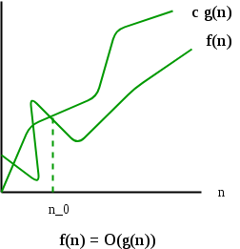
Big-O Notation (O-notation)
The upper bound of the running time of an algorithm. Therefore, it gives the worst-case complexity of an algorithm.
O(g(n)) = { f(n): there exist positive constants c and n0 such that 0 ≤ f(n) ≤ cg(n) for all n ≥ n0 }
Example: Let us consider a given function, f(n)=4n³+10n²+5n+1
Considering g(n)=n³,
f(n)⩽5g(n), for all the values of n>10
Hence, the complexity of f(n) can be represented as O(g(n)), i.e. O(n³)

Slide 4
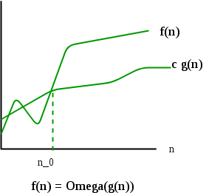
Omega Notation (Ω-Notation)
The lower bound of the running time of an algorithm. Thus, it provides the best case complexity of an algorithm.
Ω(g(n)) = { f(n): there exist positive constants c and n0 such that 0 ≤ cg(n) ≤ f(n) for all n ≥ n0 }
Example: Let us consider a given function, f(n)=4n³+10n²+5n+1
Considering g(n)=n³
f(n)⩾4g(n), for all the values of n⩾0
Hence, the complexity of f(n) can be represented as Ω(g(n)), i.e. Ω(n³)

Slide 5
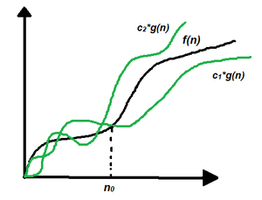
Theta Notation (Θ-Notation)
The upper and the lower bound of the running time of an algorithm, it is used for analyzing the average-case complexity of an algorithm.
Θ (g(n)) = {f(n): there exist positive constants c1, c2 and n0 such that 0 ≤ c1 * g(n) ≤ f(n) ≤ c2 * g(n) for all n ≥ n0}
Example: Let us consider a given function, f(n)=4n³+10n²+5n+1
Considering g(n)=n³
4g(n)⩽f(n)⩽5g(n), for all the large values of n.
Hence, the complexity of f(n) can be represented as θ(g(n)), i.e. θ(n³)

Slide 6
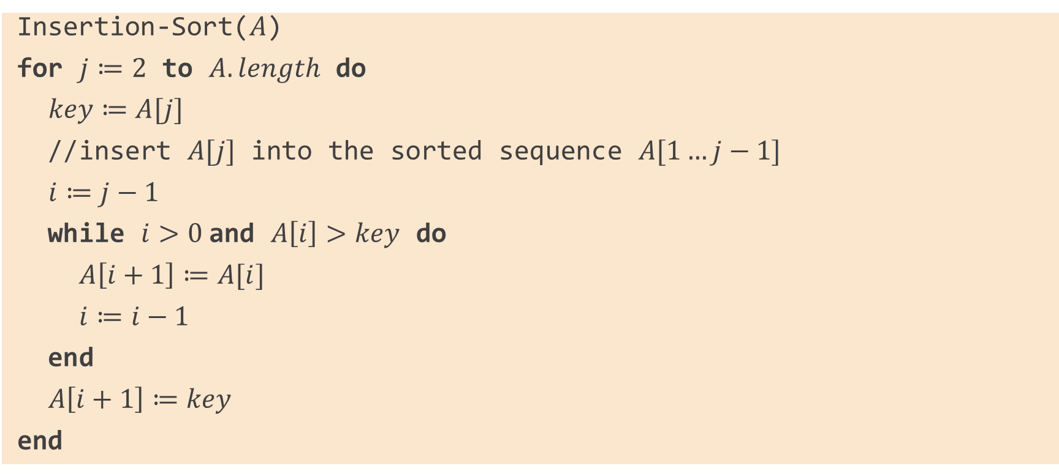
Insertion Sort Algorithm
Insertion-Sort($A$)
for $j≔2$ to $A.length$ do
$key≔A[j]$
//insert $A[j]$ into the sorted sequence $A[1…j−1]$
$i≔j−1$
while $i>0$and $A\left[i\right]>key$ do
$A\left[i+1\right]≔A[i]$
$i≔i−1$
end
$A\left[i+1\right]≔key$
end

Slide 7
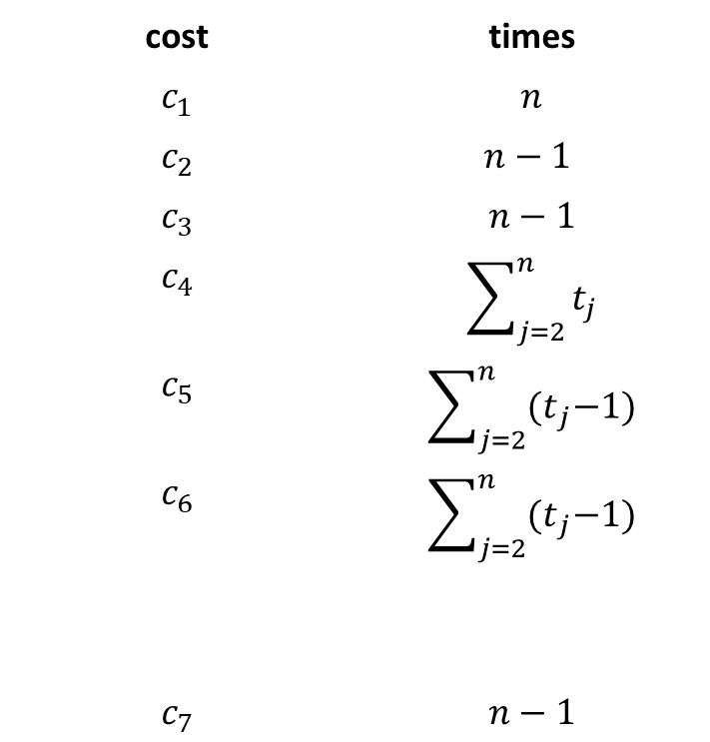

Analysis of The Insertion Sort Algorithm
cost | times
$$c_{1}$$ | $$n$$
$$c_{2}$$ | $$n−1$$
$$c_{3}$$ | $$n−1$$
$$c_{4}$$ | $$\sum_{j=2}^{n}{t_{j}}$$
$$c_{5}$$ | $$\sum_{j=2}^{n}{{(t}_{j}−1)}$$
$$c_{6}$$ | $$\sum_{j=2}^{n}{{(t}_{j}−1)}$$
$$c_{7}$$ | $$n−1$$
Insertion-Sort($A$)
for $j≔2$ to $A.length$ do
$key≔A[j]$
$i≔j−1$
while $i>0$and $A\left[i\right]>key$ do
$A\left[i+1\right]≔A[i]$
$i≔i−1$
end
$A\left[i+1\right]≔key$
end

Slide 8
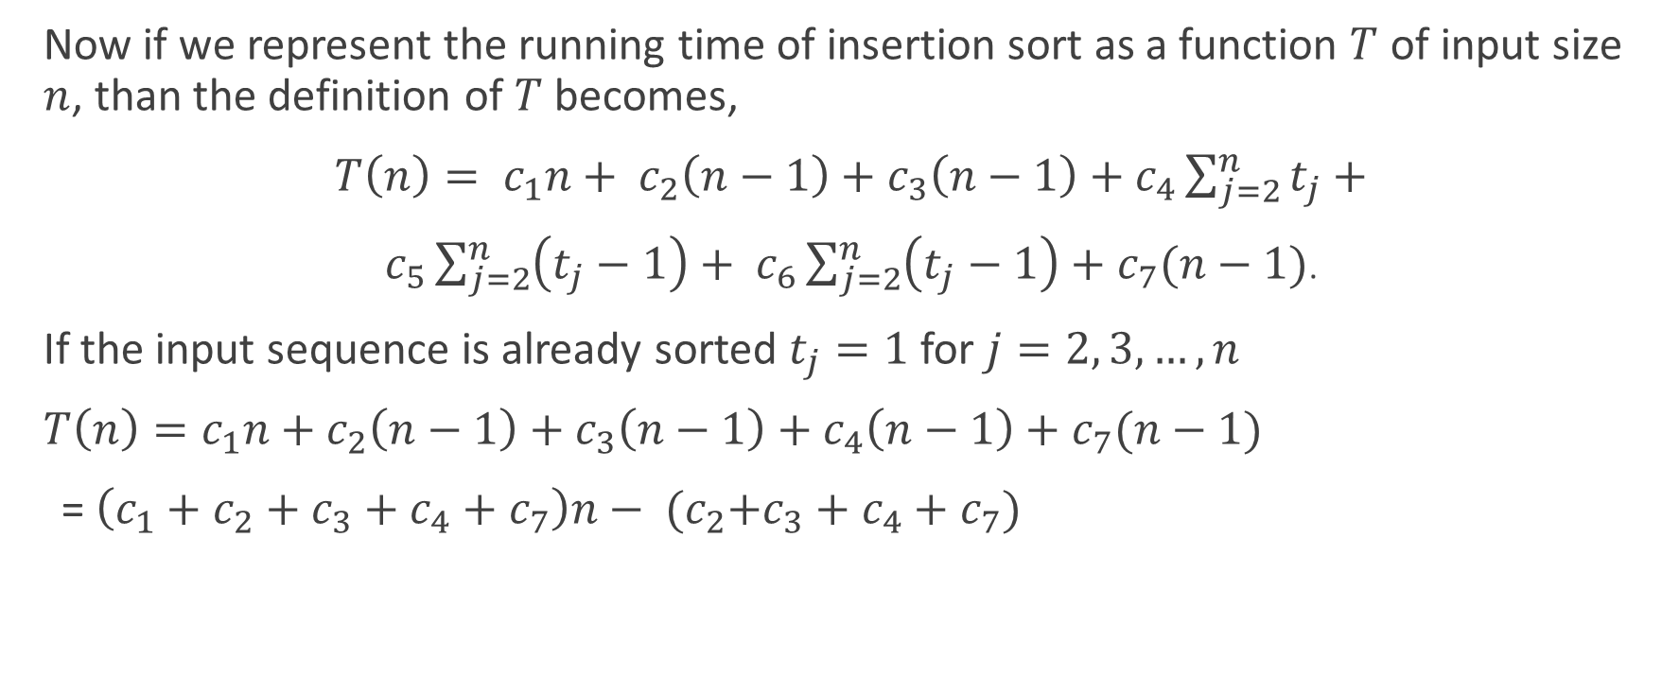
Analysis of The Insertion Sort Algorithm (Best Case)
Now if we represent the running time of insertion sort as a function $T$ of input size $n$, than the definition of $T$ becomes,
$T\left(n\right)= c_{1}n+ c_{2}\left(n−1\right)+c_{3}\left(n−1\right)+c_{4}\sum_{j=2}^{n}{t_{j}}+$
$c_{5}\sum_{j=2}^{n}{\left(t_{j}−1\right)+ c_{6}}\sum_{j=2}^{n}{\left(t_{j}−1\right)+c_{7}(n−1)}$.
If the input sequence is already sorted $t_{j}=1$ for $j=2, 3, …, n$
$T\left(n\right)=c_{1}n+c_{2}\left(n−1\right)+c_{3}\left(n−1\right)+c_{4}\left(n−1\right)+c_{7}(n−1)$
= $\left(c_{1}+c_{2}+c_{3}+c_{4}+c_{7}\right)n− {(c}_{2}+c_{3}+c_{4}+c_{7})$

Slide 9
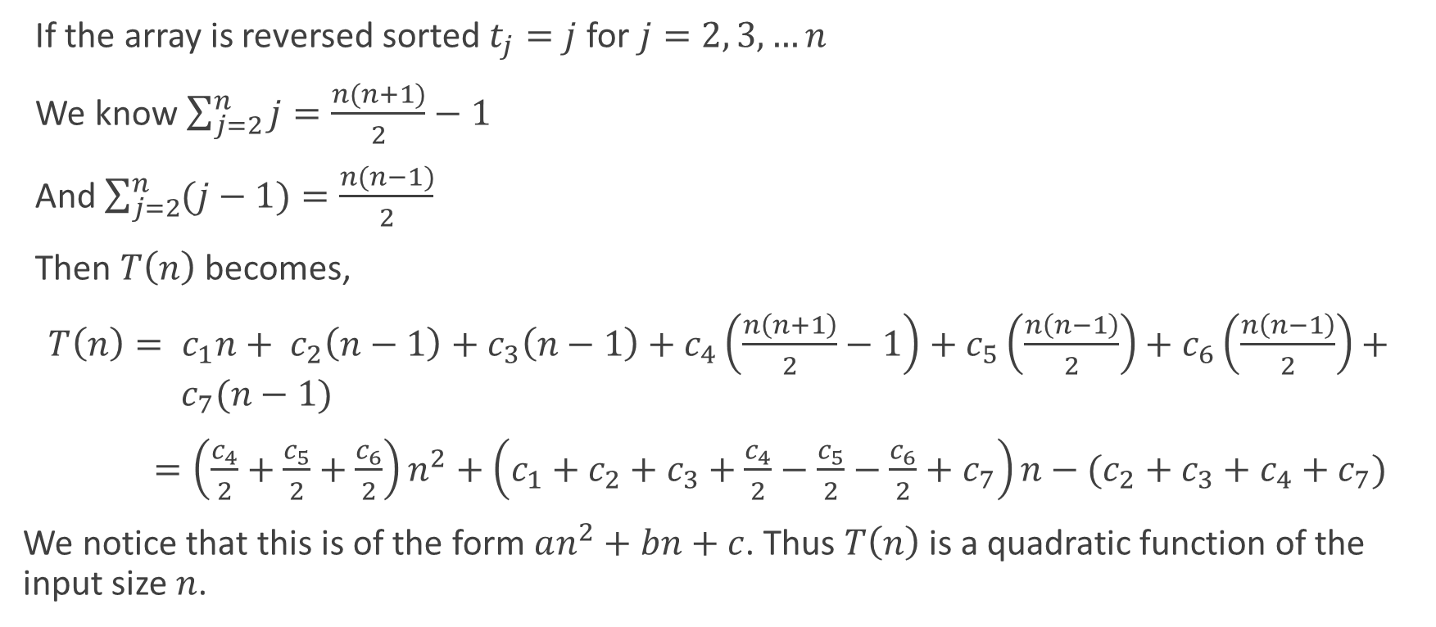
Analysis of The Insertion Sort Algorithm (Worst Case)
If the array is reversed sorted $t_{j}=j$ for $j=2, 3, …n$
We know $\sum_{j=2}^{n}{j}=\frac{n(n+1)}{2}−1$
And $\sum_{j=2}^{n}{(j−1)}=\frac{n(n−1)}{2}$
Then $T\left(n\right)$ becomes,
$T\left(n\right)= c_{1}n+ c_{2}\left(n−1\right)+c_{3}\left(n−1\right)+c_{4}\left(\frac{n\left(n+1\right)}{2}−1\right)+c_{5}\left(\frac{n\left(n−1\right)}{2}\right)+c_{6}\left(\frac{n\left(n−1\right)}{2}\right)+ { c}_{7}(n−1)$
$=\left(\frac{c_{4}}{2}+\frac{c_{5}}{2}+\frac{c_{6}}{2}\right)n^{2}+\left(c_{1}+c_{2}+c_{3}+\frac{c_{4}}{2}−\frac{c_{5}}{2}−\frac{c_{6}}{2}+c_{7}\right)n−(c_{2}+c_{3}+c_{4}+c_{7})$
We notice that this is of the form $an^{2}+bn+c$. Thus $T\left(n\right)$ is a quadratic function of the input size $n$.

Slide 10
Properties of Asymptotic Notations
General properties
If f(n) is O(g(n)), then a*f(n) is O(g(n))
If f(n) is Ω(g(n)), then a*f(n) is Ω(g(n))
Reflexive
If f(n) is given, then f(n) is O(f(n))
Transitive
If f(n) is O(g(n)) and g(n) is O(h(n)), then f(n)=O(h(n))
f(n)=n, g(n)=n², and h(n)=n³ then
n = O(n²), n² = O(n³), −>n = O(n³)
Symmetric
If f(n) is Θ (g(n)), then g(n) is Θ (f(n))
Suppose f(n)=n²; g(n)=n²
f(n)=Θ (n²)
g(n)=Θ (n²)
Transpose symmetric
If f(n) = O(g(n)), then g(n) is Ω(f(n))
f(n)=n and g(n)=n²
Then n is O(n²) and n² is Ω(n)

Slide 11
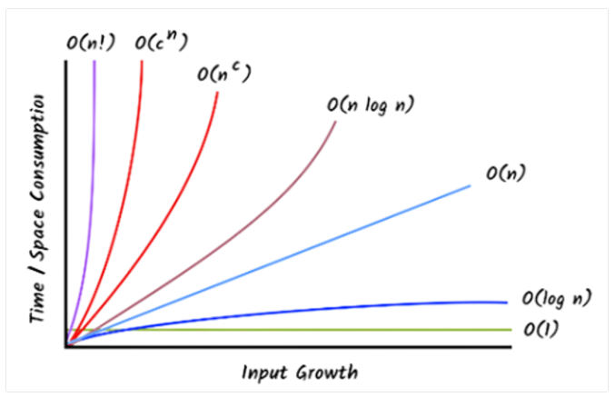
Common Asymptotic Notations
Name | Notation
Constant | O(1)
Logarithmic | O(log n)
Linear | O(n)
Linearithmic, Log-linear | O(n log n)
Quadratic | O(n²)
Polynomial | O(n^{c})
Exponential | O(c^{n}); where c>1
Factorial | O(n!)

Slide 12
Comparison of Complexities
If f1(n) = 3n logn, f2(n) = n², f3(n) = 2^{n} , then what will be the formation according to complexity in ascending order?
Answer: f1 < f2 < f3
If f1(n) = 3n logn, f2(n) = n², f3(n) = 2^{n} , f4 = 2¹⁰, then what will be the formation according to complexity in descending order?
Answer: f3 > f2 > f1 > f4.
If f1 = O(n) and f2(n) = O(logn), respectively. Therefore, “f2 always runs faster than f1” – is true or false?
Answer: Home Work.
Which one is better between f1(n) = 10⁵ and f2(n) = 5¹⁰ in terms of complexity of algorithm.
Answer: Equal. O(1).

Slide 13
Time Complexity Analysis
int a = 0, b = 0; for (i = 0; i < N; i++) { a = a + rand(); } for (j = 0; j < M; j++) { b = b + rand(); } | O(N * M) time, O(1) space O(N + M) time, O(N + M) space O(N + M) time, O(1) space O(N * M) time, O(N + M) space
int a = 0; for (i = 0; i < N; i++) { for (j = N; j > i; j--) { a = a + i + j; } } | O(N) O(N*log(N)) O(N * Sqrt(N)) O(N*N)

Slide 14
Time Complexity Analysis Cont’d
int i, j, k = 0; for (i = n / 2; i <= n; i++) { for (j = 2; j <= n; j = j * 2) { k = k + n / 2; } } | O(n) O(n log n) O(n^2) O(n²Logn)
int a = 0, i = N; while (i > 0) { a += i; i /= 2; } | O(N) O(Sqrt(N)) O(N / 2) O(log N)

Slide 15
Time Complexity Analysis Cont’d
for (int i = 1; i < n; i++) { i *= k; } | O(n) O(k) O(log_{k}n) O(log_{n}k)
int value = 0; for(int i=0;i<n;i++) for(int j=0;j<i;j++) value += 1; | n (n+1) n(n-1)/2 n(n+1)

Slide 16
Thank You

